Slide 1
Value-Add
Industrial Investment Opportunity with World-Class Sponsor
A Historic Buying Opportunity for Industrial Real Estate
Investor Overview, 2026
Notes:
Needs to work for someone with no context
Why invest in Industrial Real Estate
Value-Add Industrial Investment Opportunity with World-Class Sponsor

Slide 2
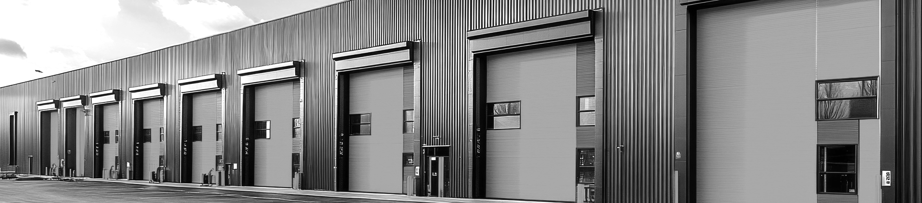
EXECUTIVE
SUMMARY
A $100M Industrial Real Estate Fund at a Generational Buying Window
The O'Donnell Group (“TOG”) is raising $100M of equity to acquire infill industrial properties in the $15–$35M range across the highest-demand U.S. corridors — capitalizing on a supply collapse, $300B+ in maturing industrial debt, and the growth of e-commerce, AI, & reshoring.
WHY NOW
WHY INDUSTRIAL
WHY TOG
Historic Window
Exceptional Asset Class
Proven Sponsor
Industrial deliveries are down ~70% from 2023; 2026 completions will be just ~1% of total stock.
$300B+ of legacy industrial debt is maturing into a higher-rate world — creating motivated sellers.
E-commerce, AI & reshoring growth greatly increases industrial demand.
Infill Industrial is critical, supply-constrained infrastructure
Industrial has achieved annual 10.4% returns for the past 20 years
Industrial NOI growth is expected to lead every other commercial real estate asset class through 2029.
Three-generation, vertically
integrated industrial sponsor.
96 projects, 38 cities since 1972
24.25M SF acquired or developed
since 1972
Industrial property-level returns
since 1996:
+50% avg IRR, 3.0× equity
Notes:
The O’Donnell Group, Inc. (“TOG”) is seeking $100mm in equity financing to acquire industrial warehouses across the U.S., to capitalize on the unrelenting demand for industrial real estate through rigorous value-based bottom-up acquisitions analysis and disciplined business plan management.
Capitalize on assets with below-market rents, cost basis below replacement costs & in need of repositioning
TOG targets “Infill” properties, a market niche with fragmented owners & supply constrictions, and leverages unique in-house operational expertise to execute on value-add strategy.

Slide 3
Institutional-Quality Industrial Sponsor
Since 1972
PROVEN TRACK RECORD
Investments
since 1996
+50%
Avg property-level IRR
1972
Year founded
96
Industrial projects completed
3.0x
Avg equity multiple
24.25M
Square feet of industrial developed
over 54 years
38
Cities with completed projects,
coast-to-coast
Across all property-level investments since 1996.
© 2024 The O’Donnell Group |
3
Notes:
Market Knowledge – history of knowing when to buy & sell…

Slide 4









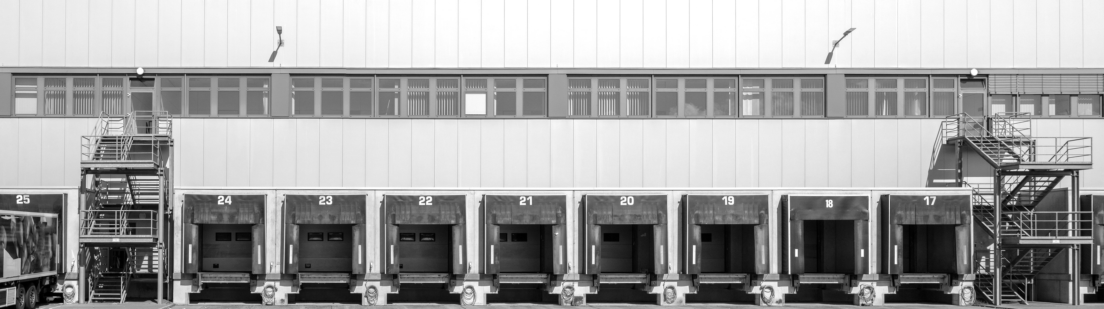

THE O’DONNELL GROUP
Douglas O’Donnell
CEO
Oliver O’Donnell
President
Shahab Taleghani
CFO
Brian Condo
Head of Investor Relations
3 Generations Family Owned & Operated
Vertically Integrated, Institutional-Quality
Michael Hubert
Marketing Director
Kate Dahl
Property Management
Angela Tesselaar
Creative Director
Peter O’Donnell
Investor Relations
We combine old-school discipline with next-generation dealmaking, operating as a family platform that thinks in decades, executes with institutional rigor, and stays focused on what we know best: industrial real estate. We’re not chasing trends—we’ve lived through cycles, built real assets, and protected capital. That shows up in how we underwrite, how we partner, and how we grow.
© 2024 The O’Donnell Group |
4
Notes:
Slide with previous institutional partners
Use TEAM slide –
Bio pics.

Slide 5






























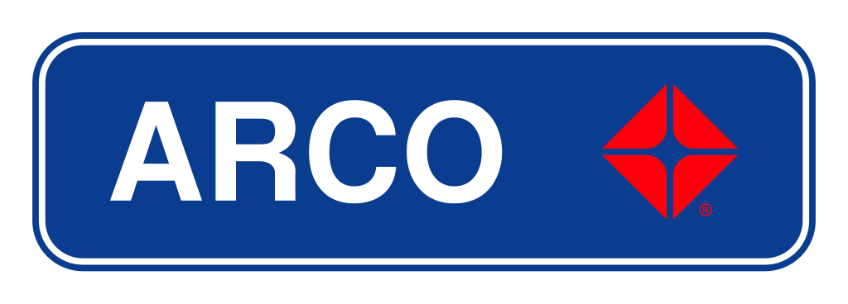


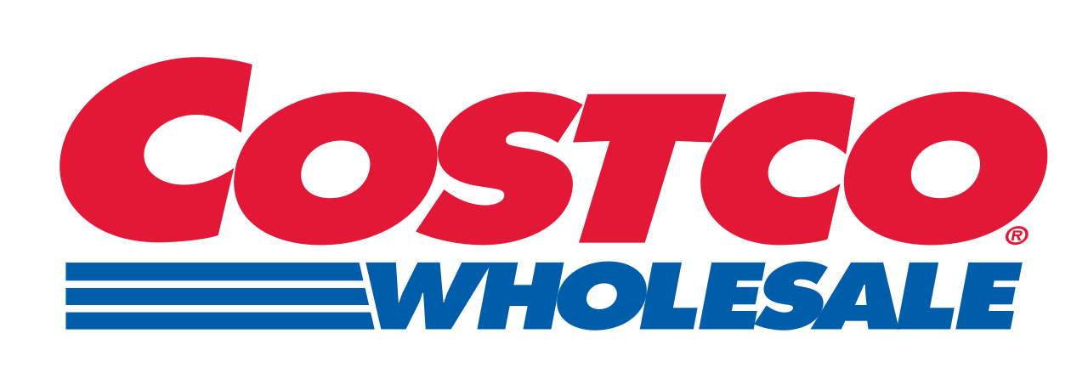
























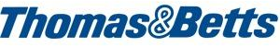






TOG IS TRUSTED
BY INSTITUTIONAL INVESTORS & NATIONAL TENANTS
INVESTOR LIST
TENANT LIST
ERNST TRUCKING
HATAI
© 2024 The O’Donnell Group |
5
Notes:
Use LOGOS

Slide 6
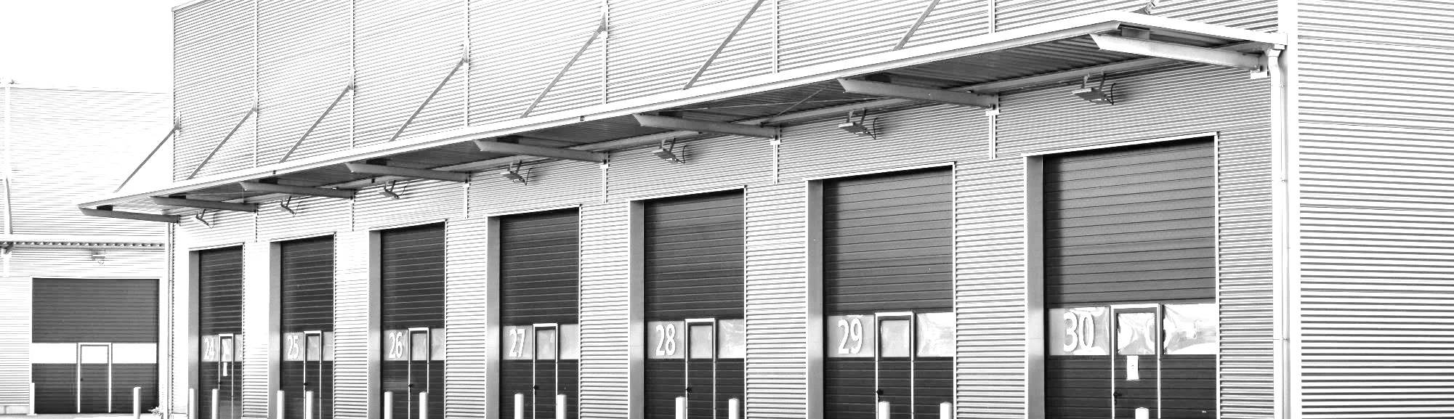
INFILL 101:
“EVERYTHING GOES THROUGH A WAREHOUSE”
Infill is Critical Last-Mile Infrastructure
Infill warehouses and distribution centers sit close to dense urban centers — making same-day and next-day delivery possible.
Warehousing typically takes up 4% to 6% of a company’s overall logistics costs […]
there’s very little an occupier can do to cut expenses for warehouses, when their business depends on them.
- The Wall Street Journal & CBRE
Structurally Supply-Constrained
Municipalities discourage new infill development due to zoning,
regulation, and aesthetic concerns.
Land is scarce, construction is expensive & new supply is
greatly constrained.
The Location is the Product; Resilient, Sticky Cash Flow
Tenants need infill for last-mile last mile deliveries and will invest in
space-specific racking, fit-out & operations. Moving is expensive.
Infill markets have tight vacancy rates which make options limited.
Notes:
U.S. industrial asking rents have increased 11.3% CAGR since 2020²
E-Commerce retail sales as a percent of total sales has increased 8% CAGR since 2019³
Federal Reserve begins interest rate easing cycle with 100 bps of rate cuts in 2024, and more cuts forecasted in 2025⁴
Everything Goes Through A Warehouse
There Are No Substitutes
Low Turnover Costs - Multiple Uses
E-Commerce (18% Of Retail Sales)
Essential And Hated! – Barriers To Entry

Slide 7
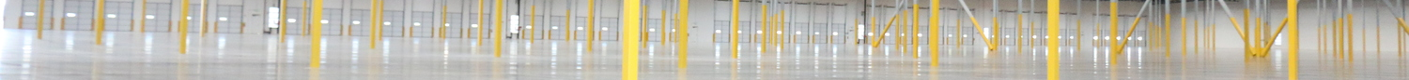
WHY INDUSTRIAL, WHY NOW:
A SUPPLY CLIFF MEETS STRUCTURAL DEMAND
MARKET OPPORTUNITY
↓ 70%
INDUSTRIAL COMPLETIONS — MILLIONS OF SQ FT
(Green Street Forecast)
Supply deliveries vs. 2023 peak.
Development starts remain near post-pandemic lows.
~1%
Of total industrial stock projected
to be delivered in 2026.
Less than half the long-term average.
7%
National vacancy rate - peaked Q3 '25
Expected to stabilize in the ~6% range by 2027.
THE
WINDOW
Rent growth projected to return to inflation-plus levels by 2027 as demand (1.5%/yr) outpaces new supply (1.2%/yr).

Slide 8

A Historic Buying Opportunity:
KEY METRICS: THEN VS. NOW
Industrial Real Estate at an Inflection Point
Metric | 2021 | Today
Interest Rates | 3.0 – 3.5% | 6.5 – 7.5%
Cap Rates | 4.0 – 5.0% | 5.5 – 6.5%
Avg Industrial Rent (NNN) | $7 – $9 / SF | $9 – $10 / SF
Debt Maturing (Est.) | - | $300B+ / yr
$300B+ in Industrial Debt Maturing
A wave of IRE loans originated in 2016–2021 is coming due, forcing owners to refinance (at higher rates) or sell
(at distressed prices)
Forced Sellers = Acquisition Opportunity
Overleveraged sponsors facing DSCR covenant breaches and margin calls will be compelled to sell — a window to acquire quality assets at discount to replacement costs
Fragmented Ownership
Infill owner/operators are traditionally small-scale, ideal targets for acquisition by veteran sponsor like TOG
Assets financed at 2021 valuations now face refinancing
at 2x the cost — with rents improving but debt loads unsustainable (window for well-capitalized buyers)
Notes:
Lack of SUPPLY –
Demand continues to OUTPACE SUPPLY.
Further accelerate value creation.
Client has UPDATED SUPPLY & DEMAND DATA

Slide 9
THREE STRUCTURAL ENGINES
ARE PULLING DEMAND IN THE SAME DIRECTION
DEMAND DRIVERS
E-COMMERCE
AI & AUTOMATION
RESHORING
3×
Warehouse space for e-commerce sales required vs. brick-and-mortar.
$34B
AI-in-manufacturing market by 2030 (+42% CAGR, TBRC).
$7T
Committed by international firms to reshore U.S. manufacturing.
20%
Of 2025 U.S. industrial net absorption came from
Amazon alone.
Mod.
Just-in-time + robotics require modern clear-height buildings.
9M SF
Supplier commitments in Phoenix alone after TSMC / Intel / LG.
+5.5%
5-yr CAGR forecast for e-commerce sales (Green Street).
Δ
Older infill assets trade at discounts — our value-add lane.
1.5-2.5
Billion SF of industrial demand per $1T reshored (JLL, C&W).
E-commerce is still only ~16% of total retail sales — runway remains.
Modernization premium widens the gap between Class A & legacy infill.
Coastal infill captures upstream/downstream supply-chain spillover.

Slide 10
INFILL INDUSTRIAL: THE MOST DEFENSIBLE SLICE OF COMMERCIAL REAL ESTATE
IN SUMMARY
Irreplaceable Locations
Critical proximity to dense urban populations, seaports, and airports — the geography of last-mile delivery.
INDUSTRIAL BY THE NUMBERS
14%
Industrial cap-ex as % of NOI — lowest of any major property type.
(Office 29% · Strip 22% · Mall 17%)
Structurally Supply-Constrained
Municipalities limit new infill development through zoning, aesthetics, and regulation. Land is scarce, construction is expensive.
23%
Industrial's share of total CRE value today,
up from 15% post-GFC.
Critical, Sticky Infrastructure
Warehousing is ~4-6% of an occupier's logistics cost — too operationally embedded to relocate. Tenants stay & vacancy rates are tight.
+40%
Industrial values over the last 5 years.
#2 long-term unlevered returns of any major property type (10.4% over 20 yrs).

Slide 11
INDUSTRIAL LEADS COMMERCIAL REAL ESTATE ON THE METRICS THAT MATTER
SAME-STORE NOI GROWTH FORECAST, 2026-2029 CAGR
Industrial leads — even at the bottom of its cycle.
20-YEAR UNLEVERED PRIVATE-MARKET RETURNS
Top 2 of all major property types over two decades.
"CRE lenders have materially shifted their portfolios toward apartment and industrial loans — while reducing exposure to retail and office."

Slide 12
INDUSTRIAL REAL ESTATE HAS RESILIENCE TO INTEREST RATE FLUCTUATIONS
Result
If Interest
Rates Go Up:
NNN Leases
Tenants pay increases in
property taxes, insurance and operating expenses
Building Replacement
Costs Increase
Making it more expensive
to increase supply
Rents Increase
If Interest
Rates Go Down:
Cap Rates Decrease
Property Values Increase
Notes:
For Example…
Current
Ten Year Rate: 4.66%
5 Year Average: 3.24%
10 Year Average: 2.88%
15 Year Average: 2.77%
20 Year Average: 2.88%
During the Financial Crisis (’08/’09) major industrial REIT’s were heavily leveraged with significant development exposure.
When credit markets froze, REITs were forced to issue deeply dilutive equity – destroying NAV & crushing long-term compounding value for shareholders.
Private markets enjoyed structural advantages during this disruption –with no mark-to-market, forced selling or public equity dilution, enabling investors to hold.
More recently: 5-year REIT return is only 5.7%, due to 2024 negative demand surprises.

Slide 13
INFILL INDUSTRIAL STRATEGY - OVERVIEW
TOG follows a highly disciplined strategy, refined over 54 years
Target
Capitalize
Operate/Manage
Undervalued industrial properties between $15mm and $35mm in
low-vacancy, dense infill locations, with proximity to seaports/airports
On assets with mark-to-market leasing, basis below replacement
cost and/or strategic
capital improvements
Leveraging vertically integrated operations + rigorous hands-on management of the full
deal lifecycle
Notes:
Differentiators:
All we do is industrial
Deep focus on Infill
1972
50% IRR avg. since 1996
3X avg. since 1996
3 Generations
Competitors won’t do property management – O’Donnell is more optimized & knows where to spend the money.

Slide 14
Private Ownership vs. REIT Exposure
20 Year Return
(Annualized)
Structural Advantages
During Disruption
During the financial crisis (’08/’09) major industrial REIT’s were heavily leveraged with significant development exposure.
When credit markets froze, REITS were forced to issue deeply dilutive equity, destroying NAV & long-term value.
Private owners could simply hold
during the duration of the crisis –
a major structural advantage.
20 Year Return
(Annualized)
*Green Street's private-market total return is the change in CPRI (income + capital value change).
**Sr. H values are a market cap weighted average of total returns for VTR
and WELL.
Source: FTSE/NAREIT Indices (public-market returns) and Green Street, CPRI data is thru 4Q25.
© 2024 The O’Donnell Group |
14
Notes:
During the Financial Crisis (’08/’09) major industrial REIT’s were heavily leveraged with significant development exposure.
When credit markets froze, REITs were forced to issue deeply dilutive equity – destroying NAV & crushing long-term compounding value for shareholders.
Private markets enjoyed structural advantages during this disruption –with no mark-to-market, forced selling or public equity dilution, enabling investors to hold.
More recently: 5-year REIT return is only 5.7%, due to 2024 negative demand surprises.

Slide 15

TOG’s $15–$35M Sweet Spot:
Off the Institutional Radar, on the Best Markets
< $15M
1031 / Retail Buyers
$50M+
Institutional Investors
$15M – $35M
TOG Sweet Spot
Too small for institutions. Too large for 1031 buyers. A fragmented market with motivated, often-unsophisticated sellers.
TOG TRACK RECORD IN THIS RANGE — SINCE 1996
+50%
3.0×
Avg property-level IRR
Avg equity multiple

Slide 16

STRICT ACQUISITION CRITERIA
Below Market Rents
Below Replacement Cost
Infill locations with proximity to population base and ports
Off Market Deals
Properties in need
of repositioning
Poorly managed and deferred maintenance
Upside potential through cash flow and/or value appreciation
Vacant buildings with excellent leasing potential

Slide 17
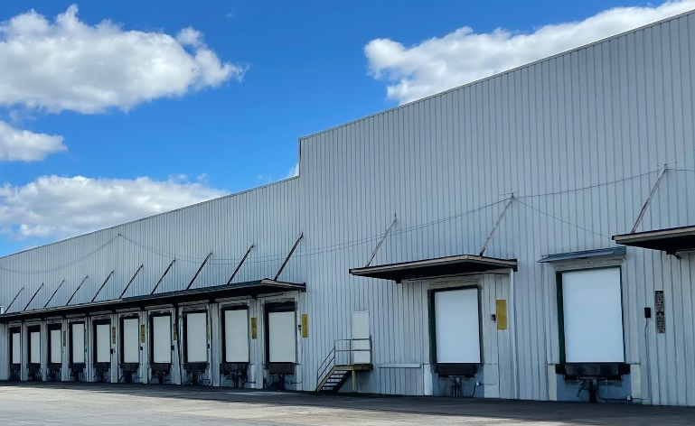
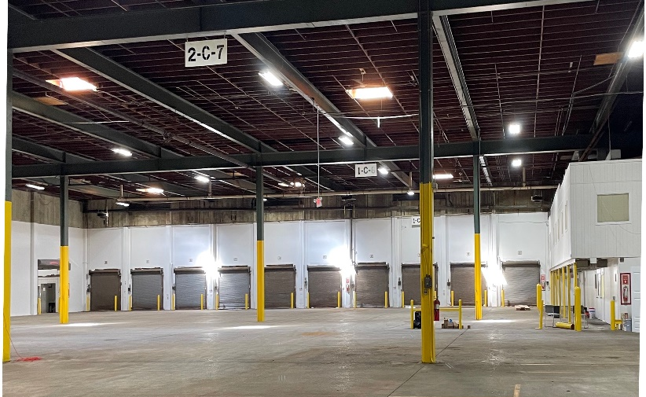
CASE STUDIES
52 LOCKE
Swedesboro, NJ
The Building comprised of 207,500 SF
on 12 acres.
BACKGROUND
TOG acquired 52 Locke in 2020 from an owner-user for $11.65mm and sold the property in 2022 to an institutional investment manager for $26.5mm.
Value Creation: TOG executed a short-term leaseback with the owner-user, meanwhile investing
in capital expenditure on roof upgrades, environmental remediation, new dock doors, levelers,
paint, and MEP upgrades.
TOG secured a new 7-year lease from a regional distribution tenant to occupy the entire building and sold the property as an investment sale.
METRIC | PROPERTY LEVEL RETURNS
IRR | +50%
Equity Multiple | 2.8x
Hold Period | 1.25 Years

Slide 18
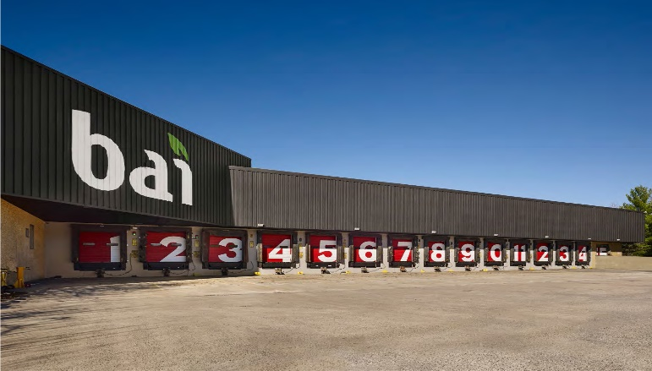
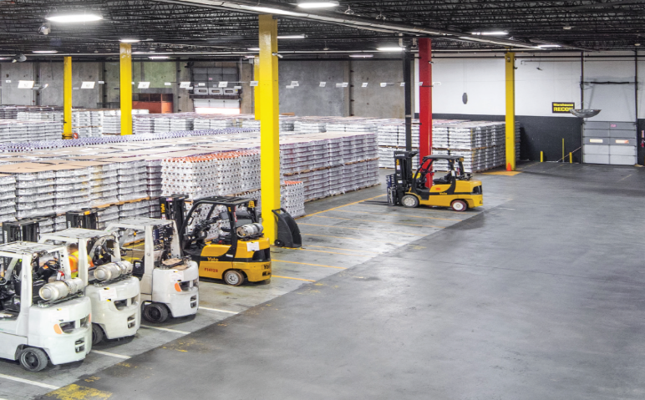
CASE STUDIES
201 ELIZABETH
Bordentown, NJ
The Building comprised of 275,631 SF
on 39 acres.
BACKGROUND
TOG acquired 201 Elizabeth in 2016 from a private investor for $17.5mm and sold the property in 2022 to an institutional investment manager for $60mm.
TOG acquired the property with BAI Drinks (NASDAQ: KDP) as the tenant with in-place rents less than half of the current market rate, with a Landlord option to terminate the lease.
TOG secured land use entitlement approvals to expand the building by an additional 140,767 SF and invested in an electric power station. TOG elected to terminate the lease with BAI Drinks and sold
the building vacant.
METRIC | PROPERTY LEVEL RETURNS
IRR | 44%
Equity Multiple | 7.0x
Hold Period | 5.4 Years

Slide 19
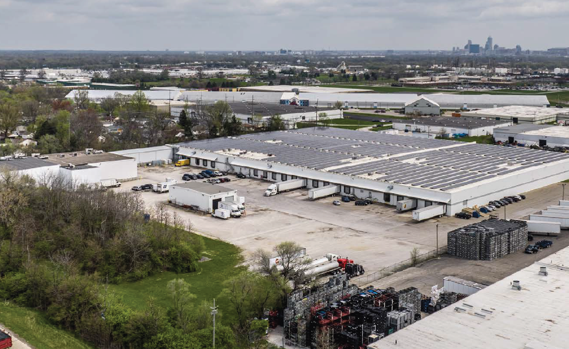
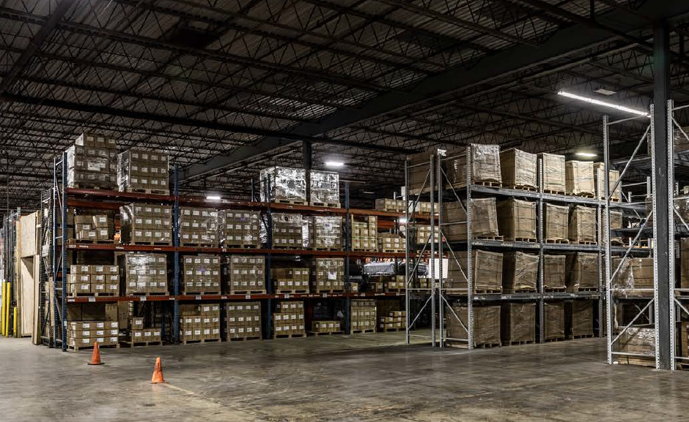
CASE STUDIES
4310 STOUT FIELD
Indianapolis, IN
The Project comprised of a distribution warehouse totaling 263,230 SF
on 13.49 acres.
BACKGROUND
In 2019, TOG bought 4310 Stout Field for $8.65mm from an owner-user.
TOG structured a sale leaseback with a 7-year lease term achieving 10% cash-on-cash during the hold period in additional to significant appreciation of the Project.
TOG invested in capital improvements consisting of a partial roof replacement, MEP upgrades, new dock door equipment, and parking lot improvements.
TOG sold the Project to a private equity firm for $15.75mm.
METRIC | PROPERTY LEVEL RETURNS
IRR | 24%
Equity Multiple | 2.9x
Hold Period | 5.4 Years

Slide 20
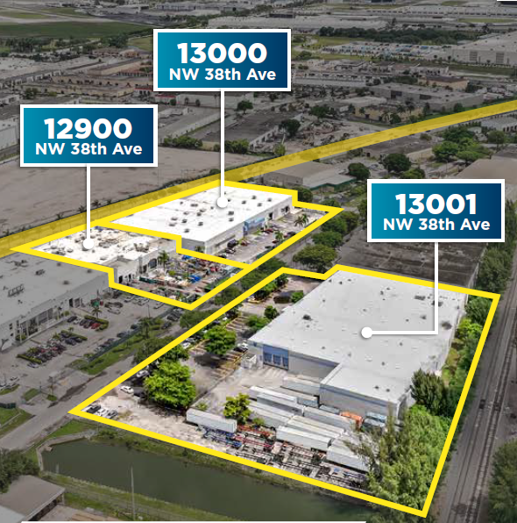
CASE STUDIES
NORTH DADE PORTFOLIO
Opa-Locka, FL
The Portfolio comprised of three adjacent warehouses totaling 142,415 SF on 6.30 acres.
BACKGROUND
TOG acquired the North Dade Portfolio from a private owner in 2022 for $17.1mm and sold the project in 2023 to an institutional investment manager $24.65mm.
TOG acquired the portfolio with 40% occupancy and $350k of NOI, and in one year leased-up the portfolio to 100% occupancy consisting of four tenants with $1.5mm of NOI.
During the lease-up process, TOG invested $2mm in capital expenditure to retrofit the warehouses.
METRIC | PROPERTY LEVEL RETURNS
IRR | 17%
Equity Multiple | 1.3x
Hold Period | 1.6 Years

Slide 21
TRACK RECORD SINCE 1996
Property |  | City | State | SF | Investment Year | Total Project Cost ($MM) | Total Equity Investment ($MM) | Exit Year | Sale Price | Hold Period (Years) | Total Proceeds ($MM) | Levered IRR | Equity Multiple ⁽²⁾
Track Record
1 | Marquart | Cerritos | CA | 123,058 | 1997 | $5.7 | $1.4 | 1999 | $7.4 | 2 | $1.7 | 46.7% | 2.2x
2 | Valley Boulevard | City of Industry | CA | 253,850 | 1997 | $9.5 | $0.5 | 1999 | $13.2 | 2 | $3.7 | 198.9% | 8.9x
3 | Mid County Tech Center | Downey | CA | 407,732 | 1998 | $15.0 | $1.5 | 2000 | $20.5 | 2 | $5.5 | 116.0% | 4.7x
4 | Sorenson Drive | Santa Fe Springs | CA | 151,618 | 1998 | $8.3 | $1.1 | 1999 | $11.5 | 1 | $3.2 | 295.9% | 4.0x
5 | Sally Place | Fullerton | CA | 201,197 | 1998 | $8.2 | $1.0 | 1999 | $11.5 | 1 | $3.3 | 326.5% | 4.3x
6 | Crescent Corporate Center | Anaheim | CA | 263,344 | 1998 | $18.7 | $6.9 | 2004 | $29.1 | 6 | $18.3 | 32.1% | 3.6x
7 | Reservoir Distribution Center | Pomona | CA | 110,250 | 1999 | $4.2 | $0.7 | 2015 | $11.4 | 16 | $11.9 | 31.6% | 17.6x
8 | O'Donnell Torrance | Torrance | CA | 380,000 | 2000 | $17.9 | $0.0 | 2003 | $33.9 | 3 | $14.5 | 200.6% | -
9 | MCBC | Santa Fe Springs | CA | 360,233 | 2000 | $15.8 | $11.0 | 2012 | $19.9 | 12 | $2.9 | 381.7% | 1.3x
10 | SFS Norwalk | Santa Fe Springs | CA | 54,000 | 2001 | $2.9 | $0.7 | 2003 | $4.1 | 2 | $1.2 | 173.2% | 2.7x
11 | O'Donnell Anaheim I⁽¹⁾ | Anaheim | CA | 192,785 | 2001 | $17.1 | $2.1 | Owned
12 | Glendora Technology Center | Glendora | CA | 84,053 | 2002 | $7.7 | $1.4 | 2004 | $10.4 | 2 | $3.0 | 87.7% | 3.2x
13 | Norwalk Boulevard Yard | Santa Fe Springs | CA | 58,990 | 2003 | $4.9 | $1.1 | 2015 | $7.2 | 12 | $5.7 | 20.9% | 6.2x
14 | Pomona Bonita | Santa Fe Springs | CA | 160,000 | 2004 | $7.9 | $1.1 | 2010 | $14.4 | 6 | $4.2 | 170.1% | 4.8x
15 | Acacia | Fullerton | CA | 51,197 | 2004 | $2.7 | $1.4 | 2006 | $4.4 | 2 | $1.2 | 32.7% | 1.9x
16 | Hall Road Business Center | Downey | CA | 147,500 | 2005 | $4.3 | $0.8 | 2006 | $9.6 | 1 | $5.2 | 636.3% | 7.9x
17 | 2426 South 7th Street | Phoenix | AZ | 60,450 | 2015 | $4.2 | $1.5 | 2017 | $5.3 | 2 | $1.2 | 37.8% | 1.8x
18 | Malone Distribution Center | Memphis | TN | 382,500 | 2016 | $10.5 | $3.5 | 2019 | $12.0 | 3 | $2.1 | 18.9% | 1.6x
19 | 201 Elizabeth | Bordentown | NJ | 275,631 | 2016 | $19.0 | $6.0 | 2022 | $60.0 | 6 | $41.9 | 44.3% | 7.0x
20 | 2209 Sulphur Road | Baltimore | MD | 313,000 | 2017 | $20.0 | $6.4 | 2021 | $25.6 | 4 | $5.1 | 20.7% | 1.8x
21 | 1908 & 1950 Stout Field | Indianapolis | IN | 166,274 | 2018 | $9.2 | $2.9 | 2024 | $12.2 | 6 | $3.9 | 19.3% | 2.4x
22 | 4310 Stout Field | Indianapolis | IN | 263,230 | 2019 | $9.7 | $3.7 | 2025 | $15.8 | 6 | $7.1 | 24.2% | 2.9x
23 | Hialeah Last Mile⁽¹⁾ | Miami | FL | 76,227 | 2020 | $15.6 | $4.0 | Owned
24 | 52 Locke Avenue | Swedesboro | NJ | 207,500 | 2020 | $14.6 | $5.7 | 2022 | $26.5 | 2 | $15.9 | 127.4% | 2.8x
25 | Bold | A-1⁽¹⁾ | Miami | FL | 116,173 | 2021 | $20.6 | $8.3 | Owned
26 | North Dade Portfolio | Opa-Locka | FL | 142,415 | 2022 | $22.7 | $10.0 | 2023 | $24.7 | 1 | $2.7 | 16.7% | 1.3x
Subtotal/Wtd. Average |  |  |  | 5,003,207 |  | $296.9 | $84.8 |  | $390.5 | 4.3 | $165.6 | 133% | 3.0x
The foregoing chart provides information regarding the historical performance of prior real estate investments made by The O’Donnell Group, Inc. or its affiliates. The performance of properties previously purchased, operated and/or sold by The O’Donnell Group, Inc. or its affiliates resulted from the unique characteristics of those properties and is not an indication or representation of performance that can be expected from future investments. The future investment’s actual results will likely differ materially from the results described above. Accordingly, the foregoing information should not be relied upon in connection with a decision whether to invest with The O’Donnell Group, Inc. or its affiliates. Past performance is no guarantee of future results. ⁽¹⁾ Properties that are owned. ⁽²⁾ Equity Multiple = (Total Equity Investment + Total Proceeds) / Total Equity Investment.

Slide 22
Long-Term Hold Value Creation Scenario
(Returns if held since 1996 and sold today)
Property |  | City | State | SF | Investment Year | Total Project Cost ($MM) | Total Equity Investment ($MM) | 2024 Valuation ($MM) | Potential Proceeds ($MM) | Equity Multiple
Track Record
1 | Marquart | Cerritos | CA | 123,058 | 1997 | $5.7 | $1.4 | $38.1 | $32.4 | 23.5x
2 | Valley Boulevard | City of Industry | CA | 253,850 | 1997 | $9.5 | $0.5 | $63.5 | $54.0 | 116.5x
3 | Mid County Tech Center | Downey | CA | 407,732 | 1998 | $15.0 | $1.5 | $142.7 | $127.7 | 86.1x
4 | Sorenson Drive | Santa Fe Springs | CA | 151,618 | 1998 | $8.3 | $1.1 | $53.1 | $44.7 | 42.6x
5 | Sally Place | Fullerton | CA | 201,197 | 1998 | $8.2 | $1.0 | $60.4 | $52.1 | 53.1x
6 | Crescent Corporate Center | Anaheim | CA | 263,344 | 1998 | $18.7 | $6.9 | $109.8 | $91.1 | 14.1x
7 | Reservoir Distribution Center | Pomona | CA | 110,250 | 1999 | $4.2 | $0.7 | $23.2 | $18.9 | 27.4x
8 | O'Donnell Torrance | Torrance | CA | 380,000 | 2000 | $17.9 | $0.0 | $125.4 | $107.5 | -
9 | MCBC | Santa Fe Springs | CA | 360,233 | 2000 | $15.8 | $11.0 | $126.1 | $110.3 | 11.0x
10 | SFS Norwalk | Santa Fe Springs | CA | 54,000 | 2001 | $2.9 | $0.7 | $20.5 | $17.6 | 25.5x
11 | O'Donnell Anaheim I⁽¹⁾ | Anaheim | CA | 192,785 | 2001 | $17.1 | $2.1 | Owned
12 | Glendora Technology Center | Glendora | CA | 84,053 | 2002 | $7.7 | $1.4 | $21.9 | $14.2 | 11.4x
13 | Norwalk Boulevard Yard | Santa Fe Springs | CA | 58,990 | 2003 | $4.9 | $1.1 | $22.4 | $17.5 | 16.9x
14 | Pomona Bonita | Santa Fe Springs | CA | 160,000 | 2004 | $7.9 | $1.1 | $56.0 | $48.1 | 44.2x
15 | Acacia | Fullerton | CA | 51,197 | 2004 | $2.7 | $1.4 | $13.3 | $10.6 | 8.4x
16 | Hall Road Business Center | Downey | CA | 147,500 | 2005 | $4.3 | $0.8 | $51.6 | $47.3 | 63.3x
17 | 2426 South 7th Street | Phoenix | AZ | 60,450 | 2015 | $4.2 | $1.5 | $11.5 | $7.3 | 5.8x
18 | Malone Distribution Center | Memphis | TN | 382,500 | 2016 | $10.5 | $3.5 | $15.3 | $4.8 | 2.4x
19 | 201 Elizabeth | Bordentown | NJ | 275,631 | 2016 | $19.0 | $6.0 | $60.0 | $41.0 | 7.9x
20 | 2209 Sulphur Road | Baltimore | MD | 313,000 | 2017 | $20.0 | $6.4 | $25.6 | $5.6 | 1.9x
21 | 1908 & 1950 Stout Field | Indianapolis | IN | 166,274 | 2018 | $9.2 | $2.9 | $12.2 | $3.0 | 2.0x
22 | 4310 Stout Field | Indianapolis | IN | 263,230 | 2019 | $9.7 | $3.7 | $15.8 | $7.1 | 2.9x
23 | Hialeah Last Mile⁽¹⁾ | Miami | FL | 76,227 | 2020 | $15.5 | $4.0 | Owned
24 | 52 Locke Avenue | Swedesboro | NJ | 207,500 | 2020 | $14.6 | $5.7 | $26.5 | $11.9 | 3.1x
25 | Bold | A-1⁽¹⁾ | Miami | FL | 116,173 | 2021 | $20.6 | $8.3 | Owned
26 | North Dade Portfolio | Opa-Locka | FL | 142,415 | 2022 | $22.7 | $10.0 | $24.7 | $1.9 | 1.2x
Subtotal/Wtd. Average |  |  |  | 5,003,207 |  | $296.9 | $84.8 | $1,119.4 | $876.8 | 11.3x
The foregoing chart provides information regarding the historical performance of prior real estate investments made by The O’Donnell Group, Inc. or its affiliates. The performance of properties previously purchased, operated and/or sold by The O’Donnell Group, Inc. or its affiliates resulted from the unique characteristics of those properties and is not an indication or representation of performance that can be expected from future investments. The future investment’s actual results will likely differ materially from the results described above. Accordingly, the foregoing information should not be relied upon in connection with a decision whether to invest with The O’Donnell Group, Inc. or its affiliates. Past performance is no guarantee of future results. (1) Properties that are owned. Income and expenses associated with the Property are excluded for simplicity. Valuation derived from sale comparables in the Property's City and SF over the last 2-3 years (Costar).

Slide 23
Investor Advantages & Alignment
TOG ADVANTAGE
Class A, Institutional-Quality Sponsor
INVESTOR-ALIGNED DEAL STRUCTURE
Direct-to-Fund Model — No Double Dip
First time available to private investors.
TOG has historically worked exclusively with institutions and pension funds. This fund opens that strategy to HNW individuals, RIAs, and family offices.
TYPICAL PRIVATE FUND: “Double Promote” Model
20-30% carry at BOTH
fund and deal level
Vertically integrated.
Institutional-quality underwriting, construction, property management, leasing, and accounting — all in-house.
TOG STRUCTURE: No “Double Promote”
Carry at the FUND
level only — on net profits.
Investor returns are not eroded by stacked fees at each level
of the structure.
Aligned with the family balance sheet.
TOG principals are personally invested across the strategy.

Slide 24
FUND STRUCTURE AT-A-GLANCE
INVESTMENT TERMS
First Time Available to Private Investors — On Institutional Terms
Total Equity | $100M Fund and/or One-Off Deals
Target Strategy | Value-Add / Opportunistic Industrial
Target Product | Class A and B distribution warehouses
Geography | Major United States markets
Average Deal Size | $15M – $35M
Leverage | 65% loan-to-cost
Target Property IRR | +15%
Preferred Return | 8% to LPs
Promote | 80/20 up to 20% IRR · 70/30 thereafter
Asset Mgmt Fee | 2% / yr on net LP equity invested
Hold Period | 2 – 5 years per asset
Investment Period | 3 – 5 years
WHY INVEST
Historic buying window · Proven strategy since 1996 · Vertically integrated operations · Aligned fee structure

Slide 25


CEO: DOUGLAS O’DONNELL
The O’Donnell Group, Inc.
567 San Nicolas Drive
Suite 450
Newport Beach, CA 92660
Email: dod@odonnellgroup.com
Cell: +1 949 633 3684
www.odonnellgroup.com

Slide 26
LEGAL DISCLAIMER
This presentation (the “Presentation”) has been prepared by The O’Donnell Group, Inc. (“TOG” or the “Company”) solely for informational and discussion purposes in connection with a potential investment in one or more real estate investment vehicles (the “Fund”). This Presentation does not constitute an offer to sell or a solicitation of an offer to buy any securities, nor shall it form the basis of, or be relied upon in connection with, any contract or investment decision.
Any such offer or solicitation will be made only through definitive offering documents, including a private placement memorandum, limited partnership agreement, subscription documents, and other related materials (collectively, the “Offering Documents”), which will contain more complete information about the Fund, including investment objectives, risks, fees, and expenses. In the event of any inconsistency between this Presentation and the Offering Documents, the Offering Documents shall control.
This Presentation contains forward-looking statements, estimates, projections, and opinions that are inherently uncertain and subject to change without notice. Actual results may differ materially from those expressed or implied due to a variety of factors, including but not limited to market conditions, economic trends, regulatory changes, interest rate fluctuations, and other risks associated with real estate investments. TOG makes no representation or warranty, express or implied, as to the accuracy or completeness of the information contained herein, and nothing contained in this Presentation shall be relied upon as a promise or representation as to future performance.
Past performance is not indicative of future results. No assurance can be given that the Fund will achieve its investment objectives or that investors will receive a return of their capital.
Investing in real estate and private funds involves a high degree of risk, including the possible loss of the entire investment. Such investments are typically illiquid, subject to restrictions on transfer, and intended for sophisticated investors who have the financial ability and willingness to accept such risks.
This Presentation is confidential and proprietary to TOG and has been provided solely for use by the intended recipient. It may not be reproduced, distributed, or disclosed, in whole or in part, without the prior written consent of TOG.
Prospective investors are encouraged to conduct their own independent investigation and consult with their own legal, tax, and financial advisors prior to making any investment decision.

